Slide 1
Automatic Text Summarization
TextRank
布丁布丁吃布丁
2022

Slide 2
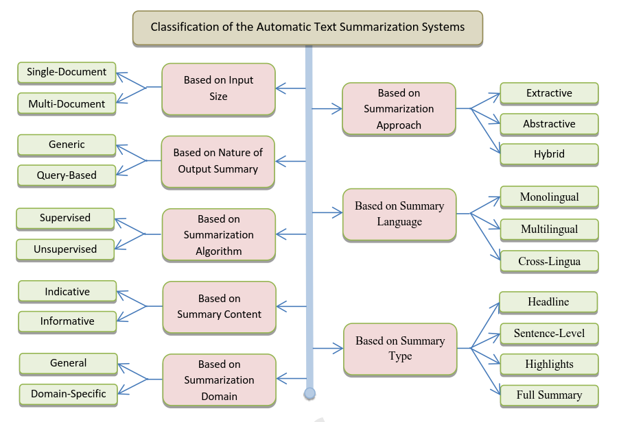
Classification of the Automatic Text Summarization Systems
(El-Kassas, Salama, Rafea, & Mohamed, 2021)
Notes:
Automatic Text Summarization

Slide 3
Text Summarization Approaches
Extractive (萃取式)
Abstractive (重寫式)
Extraction of the most important sentences from the input document
Higher accuracy: the summary with the exact terminologies that exist in the original text
Faster and simpler
Generate a summary by understanding the main concepts in the input document
Paraphrasing the text to express those concepts in fewer words
Using a clear language
(El-Kassas, Salama, Rafea, & Mohamed, 2021)

Slide 4
Graph-Based Extractive Text Summarization
TextRank
TextRank algorithm is a graph-based approach inspired by the methodology of PageRank.
The PageRank algorithm of Google is a ranking algorithm for web pages available online based on the search results.
TextRank is a widely used method as no prior requirements of linguistic or domain knowledge.
TextRank is an unsupervised approach for text summarization to generate extraction based summaries.

Slide 5
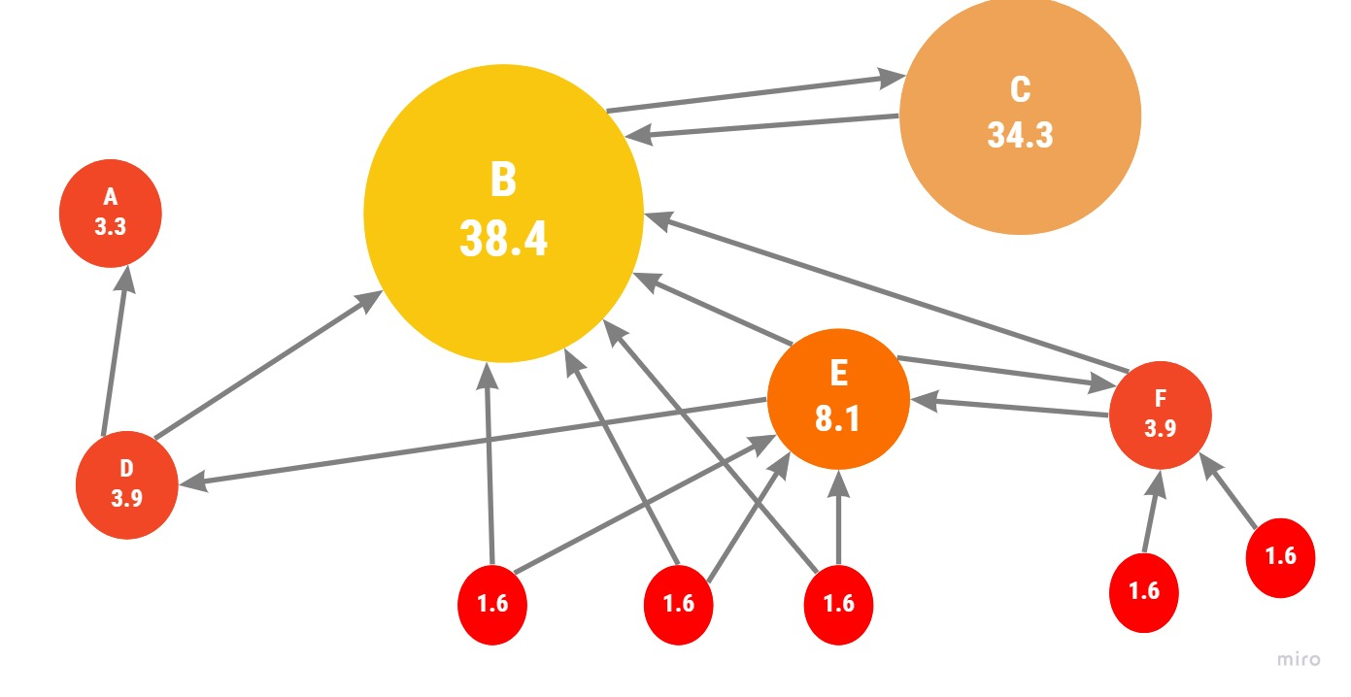
The Graph-Based Ranking Model
PageRank
(1998)
TextRank
(2004)

Slide 6
TextRank algorithm
Segment document into sentences.
Create representation of each sentences.
Score sentences.
Create a similarity matrix: measure similarity of sentences by Cosine Similarity.
Run the graph-based algorithm to calculate the score of sentences.
Select the top ranked sentences as the summary.
Notes:
https://www.slideshare.net/andrewkoo/textrank-algorithm?qid=df925632-c81e-44d0-993a-4e3e7221a3ca&v=&b=&from_search=3

Slide 7
Step 1. Segmentation
“Hi world! Hello world! This is Tim.”
[ “Hi world!”,
“Hello world!”,
“This is Tim.”
]

Slide 8
Step 2. Representation
Representation
Sen | Word Index | Word
0 | 0 | hi
0 | 1 | world
1 | 2 | hello
1 | 1 | world
2 | 3 | this
2 | 4 | is
2 | 5 | tim
[ “Hi world!”,
“Hello world!”,
“This is Tim.”
]

Slide 9
Step 3a. Creating a similarity matrix:
Representation
Sen | Word Index
0 | 0
0 | 1
1 | 2
1 | 1
2 | 3
2 | 4
2 | 5
Similarity Matrix
 | 0 | 1 | 2
0 | 1 | 0.366 | 0
1 | 0.366 | 1 | 0
2 | 0 | 0 | 1
Notes:
相似度演算法，相似度矩陣

Slide 10
Step 3b. Graph-based algorithm (1/2)
Iteration 0:
Iteration 1:
Run on the graph for several iterations until it converges…
(Nenkova & McKeown, 2012)

Slide 11
Step 3b. Graph-based algorithm (1/2)
Iteration 0:
Iteration 1:
Run on the graph for several iterations until it converges…
(Nenkova & McKeown, 2012)

Slide 12
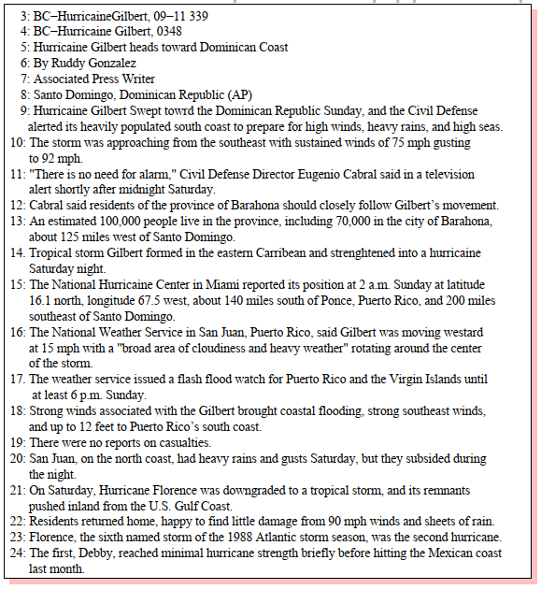
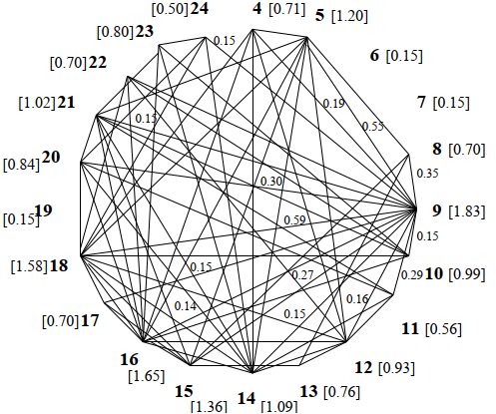
Step 3b. Graph-based algorithm (2/2)
(Mihalcea, & Tarau, 2004)

Slide 13
Step 4. Select sentences
[9] Hurricane Gilbert swept toward the Dominican Republic Sunday, and the Civil …
[16] The National Hurricane Center in Miami reported its position at 2 a.m. Sunday at latitude 16.1 north…
[15] The National Weather Service in San Juan, Puerto Rico, said Gilbert was moving westward at 15 mph…
(Mihalcea, & Tarau, 2004)

Slide 14
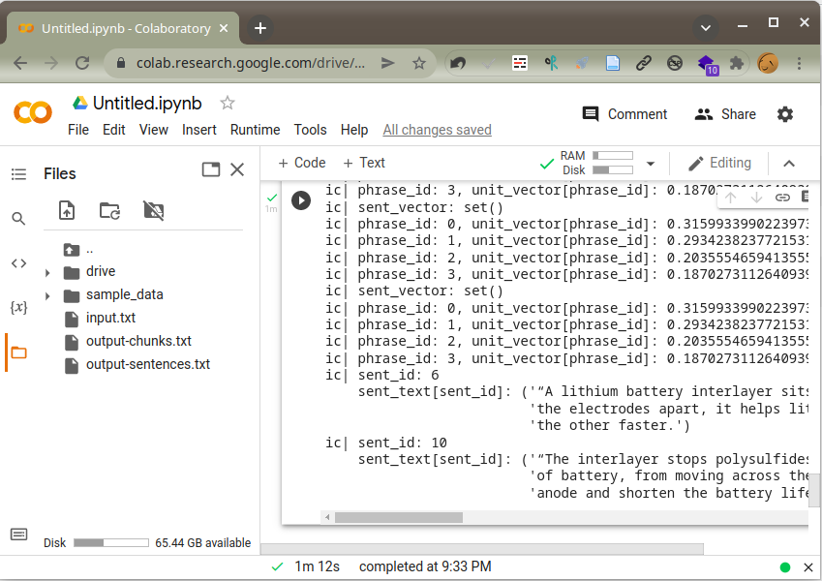
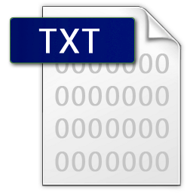
TextRank Practice
input.txt
output.txt
colab
Notes:
四個格子，四個步驟

Slide 15
Reference
Mihalcea, R., & Tarau, P. (2004). Textrank: Bringing order into text. Proceedings of the 2004 Conference on Empirical Methods in Natural Language Processing, 404–411.
El-Kassas, W. S., Salama, C. R., Rafea, A. A., & Mohamed, H. K. (2021). Automatic text summarization: A comprehensive survey. Expert Systems with Applications, 165, 113679. https://doi.org/10.1016/j.eswa.2020.113679
PyTextRank. (2022). [Python]. derwen.ai. https://github.com/DerwenAI/pytextrank (Original work published 2016)

Slide 16
Thank You
for Your Attention
布丁布丁吃什麼？ https://blog.pulipuli.info/
pulipuli.chen@gmail.com

